Slide 2
Breakdown of Tasks
Software
Goal - to create efficient, reliable software
Developed using Arduino
Continuous improvement by codeshare.io
Researched library functions for hardware
Learned how to code a state machine for each task

Slide 3
Software
Development
Optimization
Learning arduino: functions, serial monitor, PWM
Implementing libraries for sensors and shield
Refactoring code: readability, complexity
Decreasing run time: removing STOP( ) from turns
Continuous improvement by codeshare.io
Increasing motor speed and decreasing delay( )
Implementing a state machine

Slide 4
Breakdown of Tasks
Hardware
Goal - to minimize cost and maximize hardware capabilities
Researched datasheets and circuit diagrams
Calculated power efficiency, torque, budget requirements (WDM)
Bought hardware components through Amazon Prime, Lee’s, & RP
Individually tested and calibrated the sensors to ensure reliability

Slide 5
Hardware
Assembly
Optimization
Building a platform for module 3
Motor shield vs breadboard
Calibrating sensors
Module placement to avoid interference
Learning how to solder nicely
Wire organization and pins analysis
Researching datasheets and suppliers: power, torque, cost calculations

Slide 6
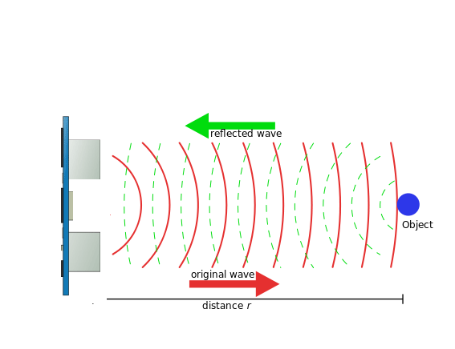
Bin Detection
Used HC-SR04 UltraSonic Sensor
If robot detects a bin from center of tape, within 1 meter, it moves forwards
Emits a high-frequency sound wave and measures how long it takes for wave to be reflected back.
Multiply by speed of sound, to obtain distance to nearest object and divide by 2.

Slide 7
Navigation Hardware
List of components used:
Sunfounder IIC IC Infrared Line Following Module
GWS Continuous-Motion Servo Motor
Adafruit Motor Shield V1
UltraSonic Sensor

Slide 8
Navigation Software
Main challenge was tracking which bins had been visited
Resolved by turning robot to face the visited bin
Developed 2 different techniques for rotating the robot around
Optimized all the versions and used the most consistent and reliable program

Slide 9
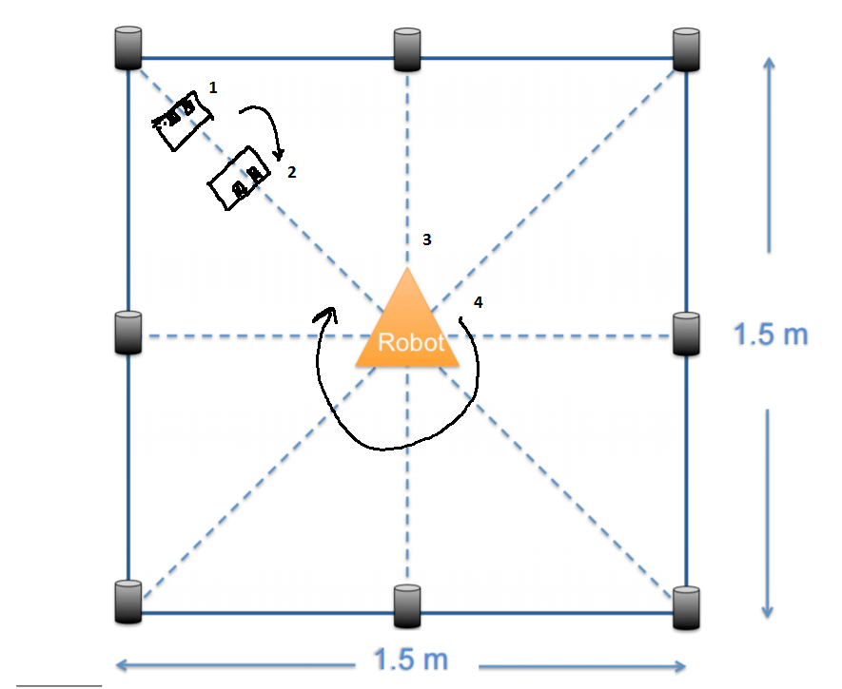
Turning Algorithm - Method 1
Robot reaches the bin, using central sensors to guide itself.
Rotates 180 degrees, until central sensors are on the black tape
Travels back to center for a preset time
Rotates 180 degrees to face the visited bin again

Slide 10
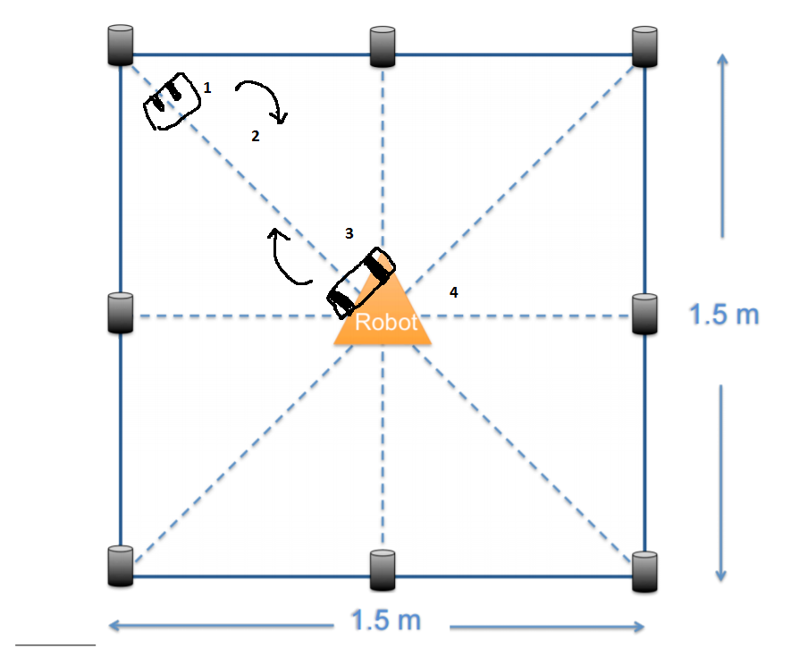
Turning Algorithm - Method 2
Robot reaches the bin, using central sensors to guide itself.
Rotates 180 degrees, until central sensors are on the black tape
Travels back to center until outside sensors see black tape
Go backwards for a preset time
We chose Method 1, as it is easier to implement and has less risk involved.

Slide 11
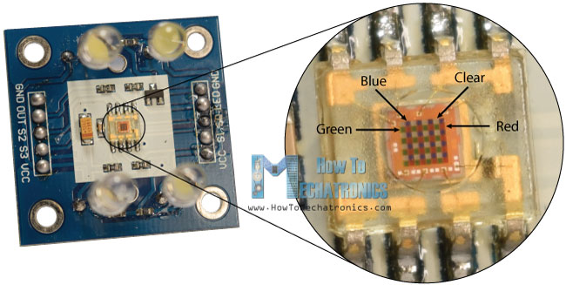
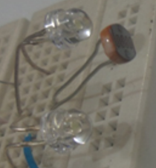
Color Detection
TCS 3200 (photodiodes)
Photo resistor
Notes:
If we take a closer look at the sensor we can see how it detects various colors. The photodiodes have three different color filters. Sixteen of them have red filters, another 16 have green filters, another 16 have blue filters and the other 16 photodiodes are clear with no filters.
The sensor has two more control pins, S0 and S1 which are used for scaling the output frequency. The frequency can be scaled to three different preset values of 100 %, 20 % or 2%. This frequency-scaling function allows the output of the sensor to be optimized for various frequency counters or microcontrollers.

Slide 12
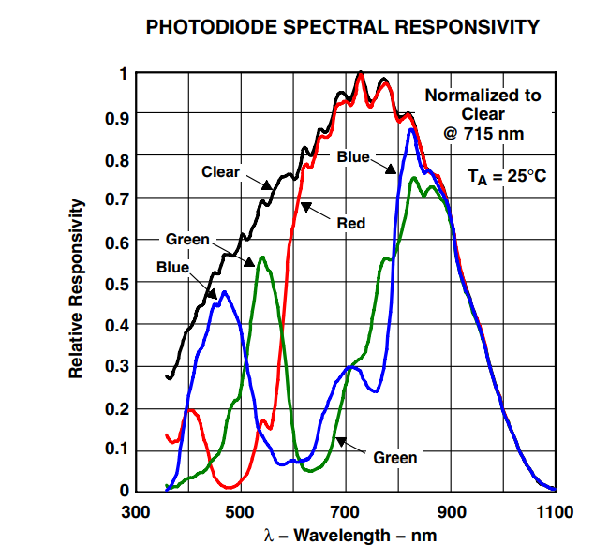
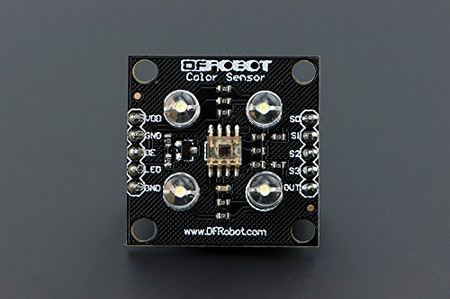
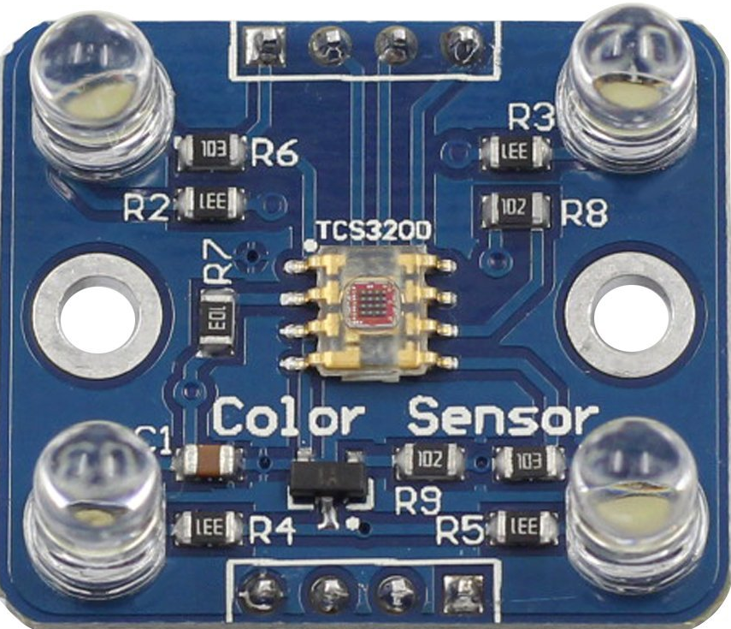
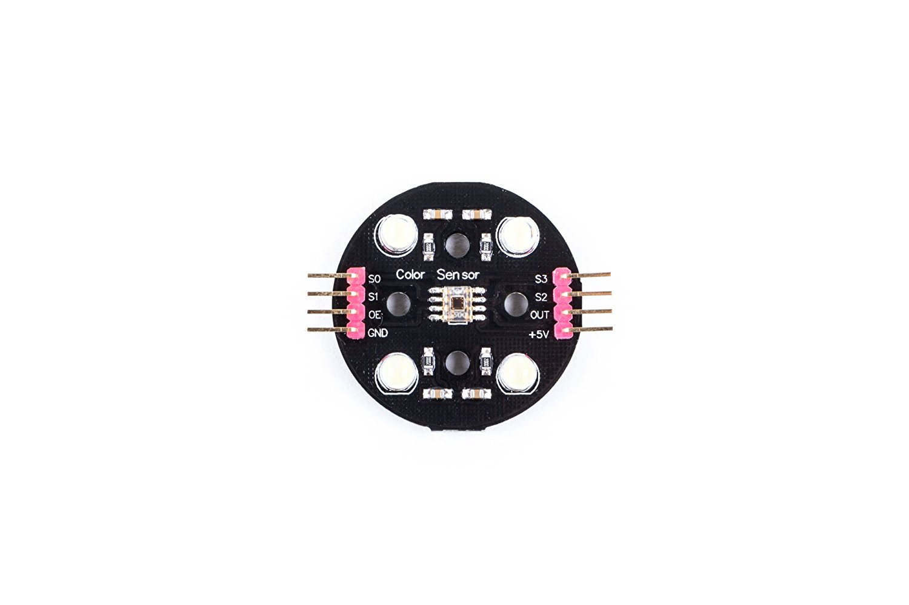
Color Detection

Slide 13
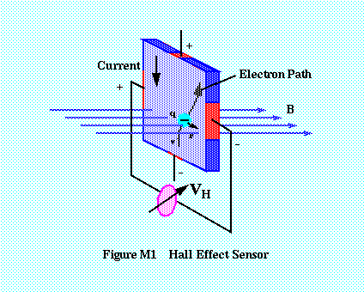
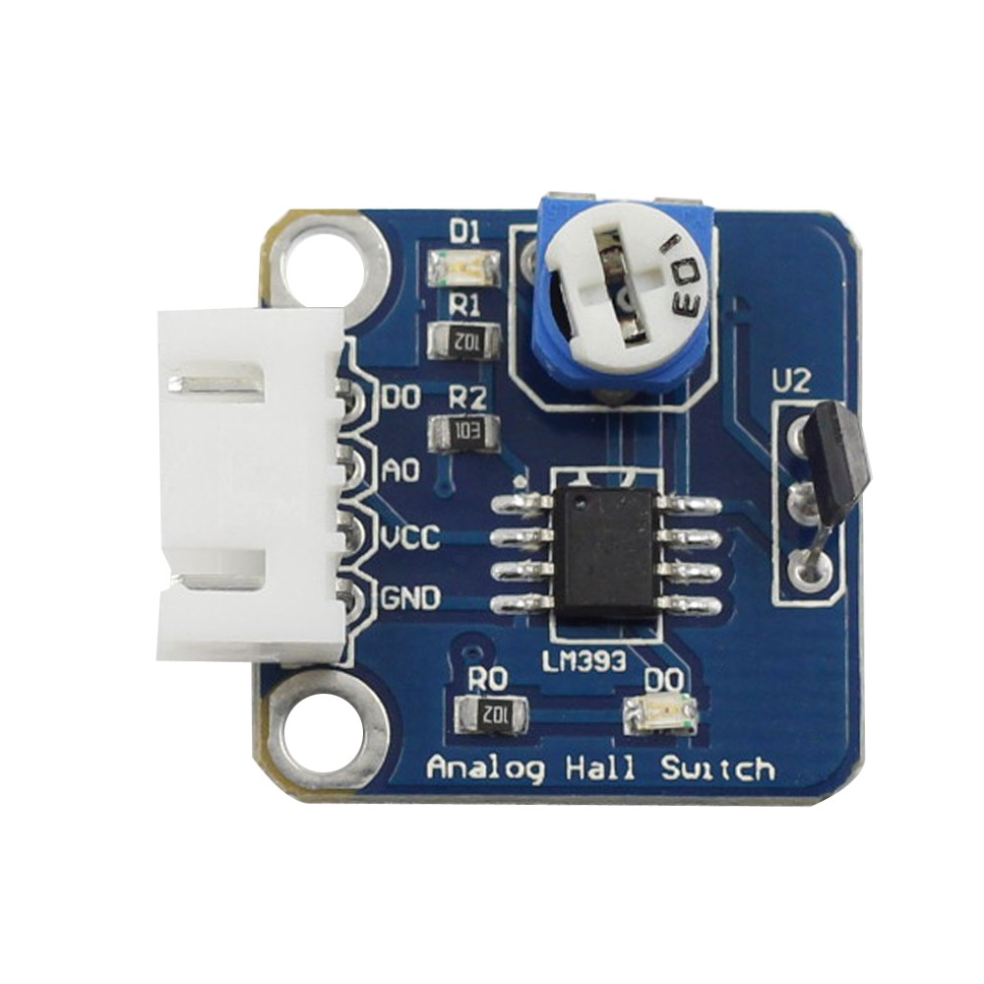
Separation of Magnet and Plastic
Analog Hall Sensor

Slide 14
Logic for Separation
Used Binary Logic
Sensor base H intensity value is 522-526
Used state machine to implement disposing
States: Left and Right
Used Servo library to control servo

Slide 15
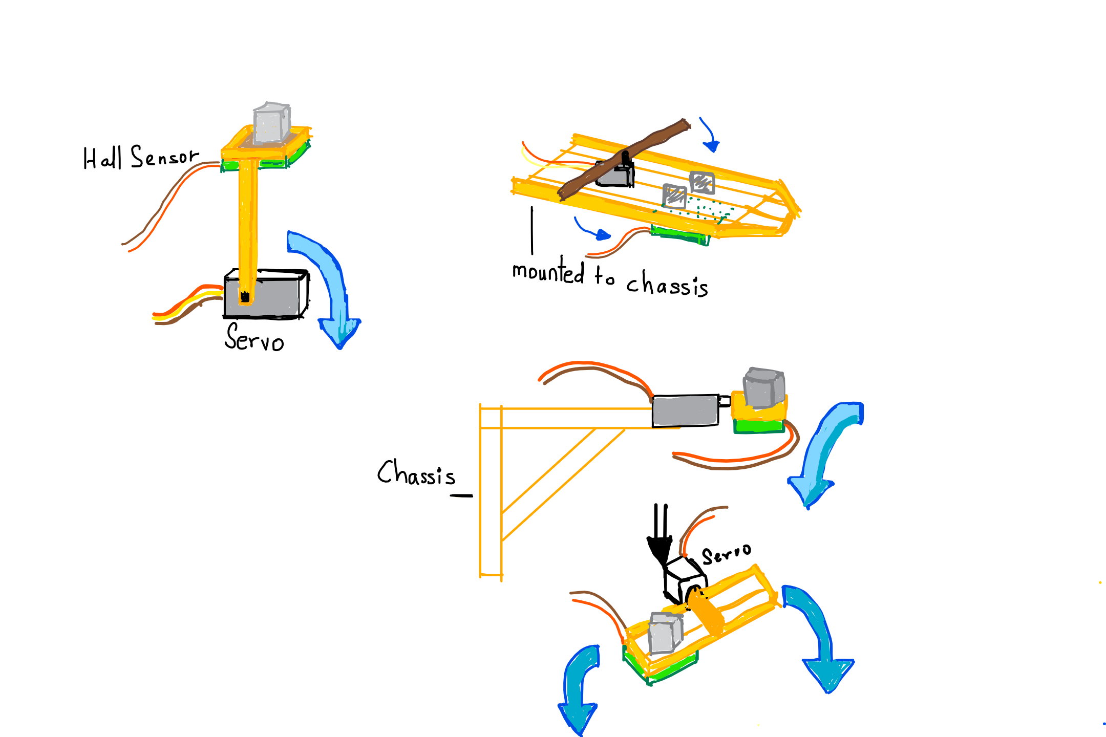
Disposing Mechanism
2
1

Slide 16
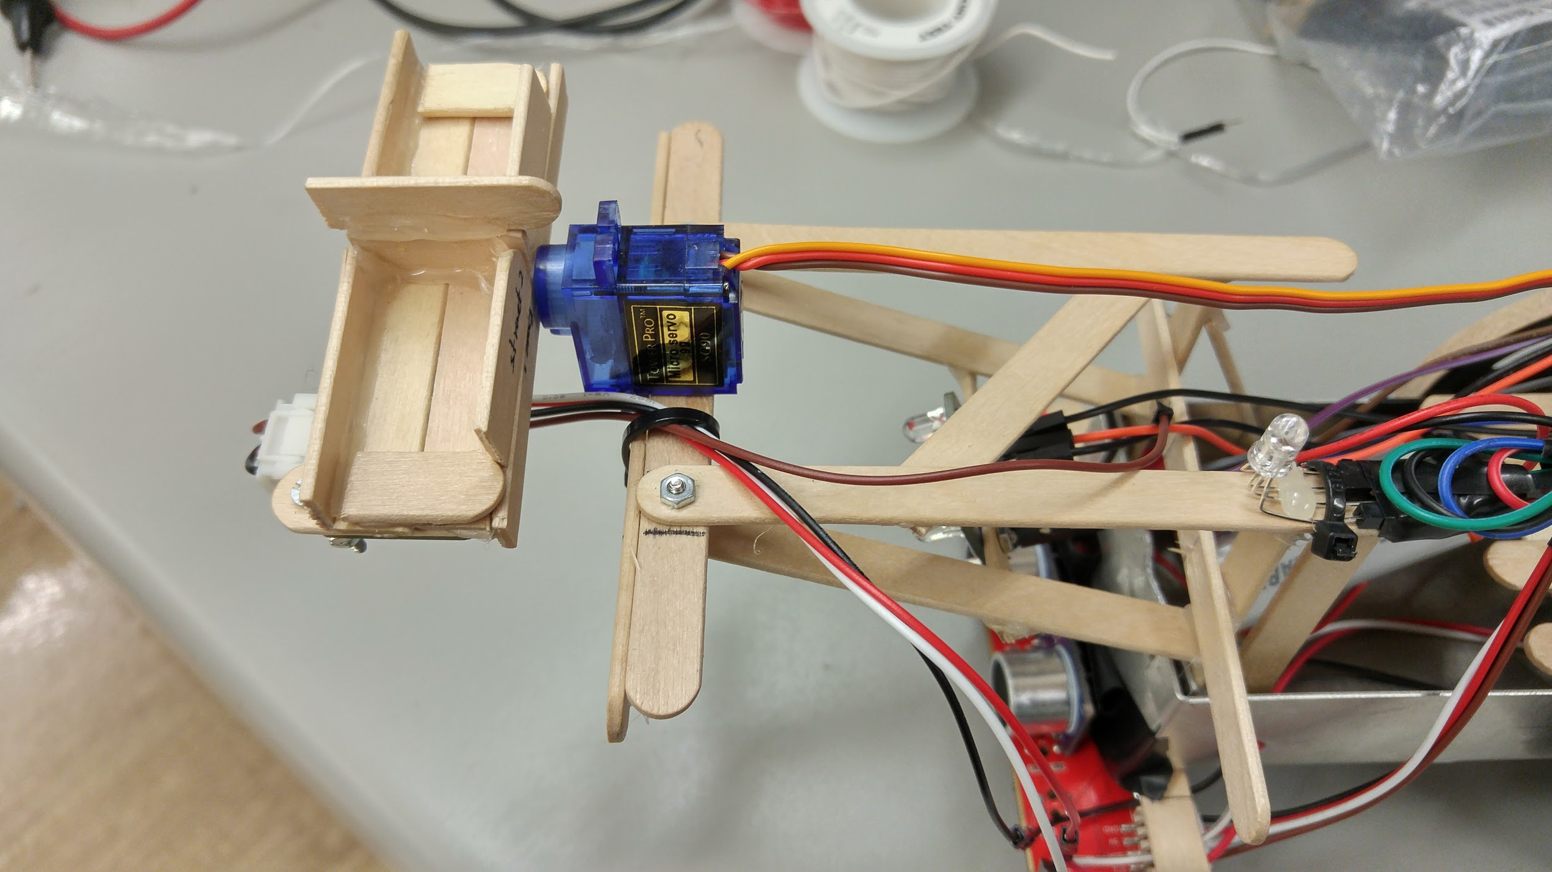
Disposing Mechanism
3

Slide 17
Integration of Parts
Continuous integration going through the modules
Pin analysis was used whilst combining modules together
Created an insulating platform to separate arduino

Slide 18
Integration of Parts
Pins Used | Part
0, 1 | serial comm
2, 3 | trigger, echo
4, 7, 8, 12 | motor shield
5, 6 | motors
9 | servo
A0, A1, A3 | blue LED, green LED, red LED
A2 | magnetic sensor
A4, A5 | SDA, SCL
10, 13 | S2, S3
11 | color sensor
Pin analysis

Slide 19
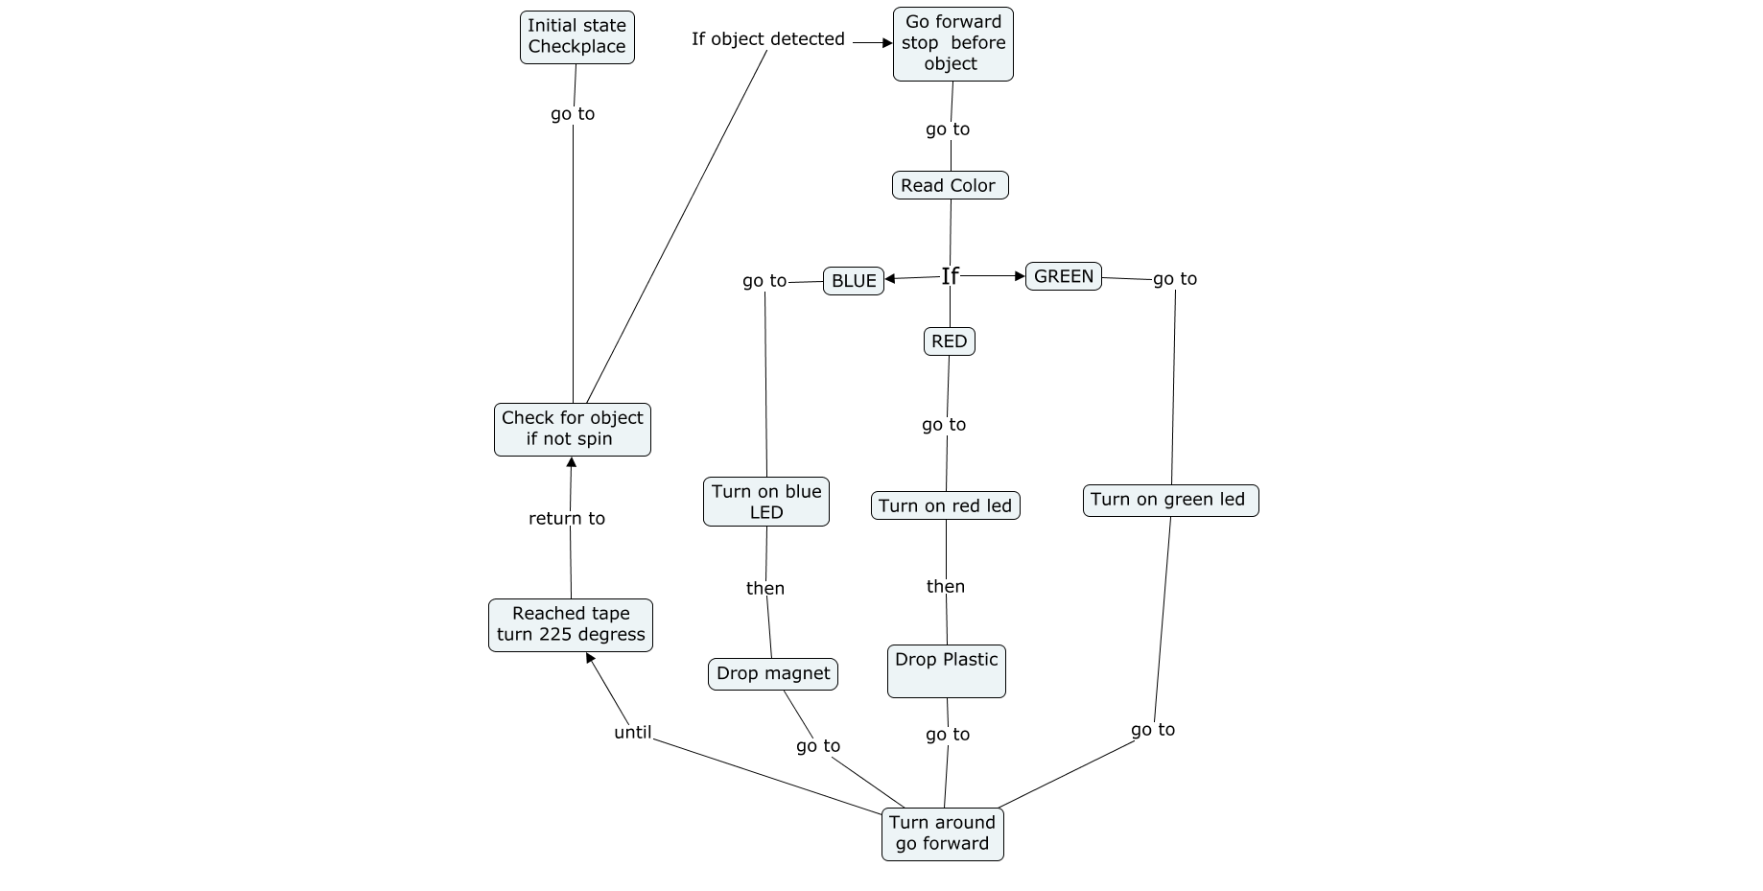

Slide 20
Challenges Faced
Debugging: is it a hardware or software problem?
Power issues: are all modules getting enough power?
Position issues: color and ultrasonic sensor conflicting with each other
Most challenging aspect of project: color calibration

Slide 21
Demo

